Slide 1
NGO Management System
Making a Difference
-Hanan Alsalamah
-Sneha Malshetti
-Sushrut Tadwalkar

Slide 2
Problem Statement
Consider this,
You are an organization who wants to donate for a social cause but you don’t know how to reach it.
NGO Management System’s advent bridges the gap between the needy and the philanthropic.

Slide 3
Approach
We first considered the important entities that will take part in the donation process.
The Benefactor
The NGO
The target Institution
Then we recognized supporting institution as
The Vendor Company

Slide 4
Approach
The idea is that a Benefactor can contribute absolutely anything he or she wants like, food, money, cloths, etc.
The NGO company affiliated to these Benefactor companies has also adopted a few institutions under its Target institutions.
This Application acts as a bridge between those who need and those who are willing to give.

Slide 5
Approach
As this app grows with more NGOS there will be a greater network of people to help the less fortunate.
We also help Creating and managing events for these institutuions through this application.

Slide 6
Use Cases
A Special Feature is that kids at every Seasonal celebration get to request for wishes that go to the NGO and the NGO display it to the Benefactors and the target company fulfills the wishes of the Target Institutions

Slide 7
Use Cases
At Any point in time the Donating company can donate any resource, which goes to the NGO and the NGO makes use of those resources to conduct events for the target institutions.
The target company can ask for its needs and the NGOs can use their collected funds to fulfill their target companies
The Targetcompany

Slide 8
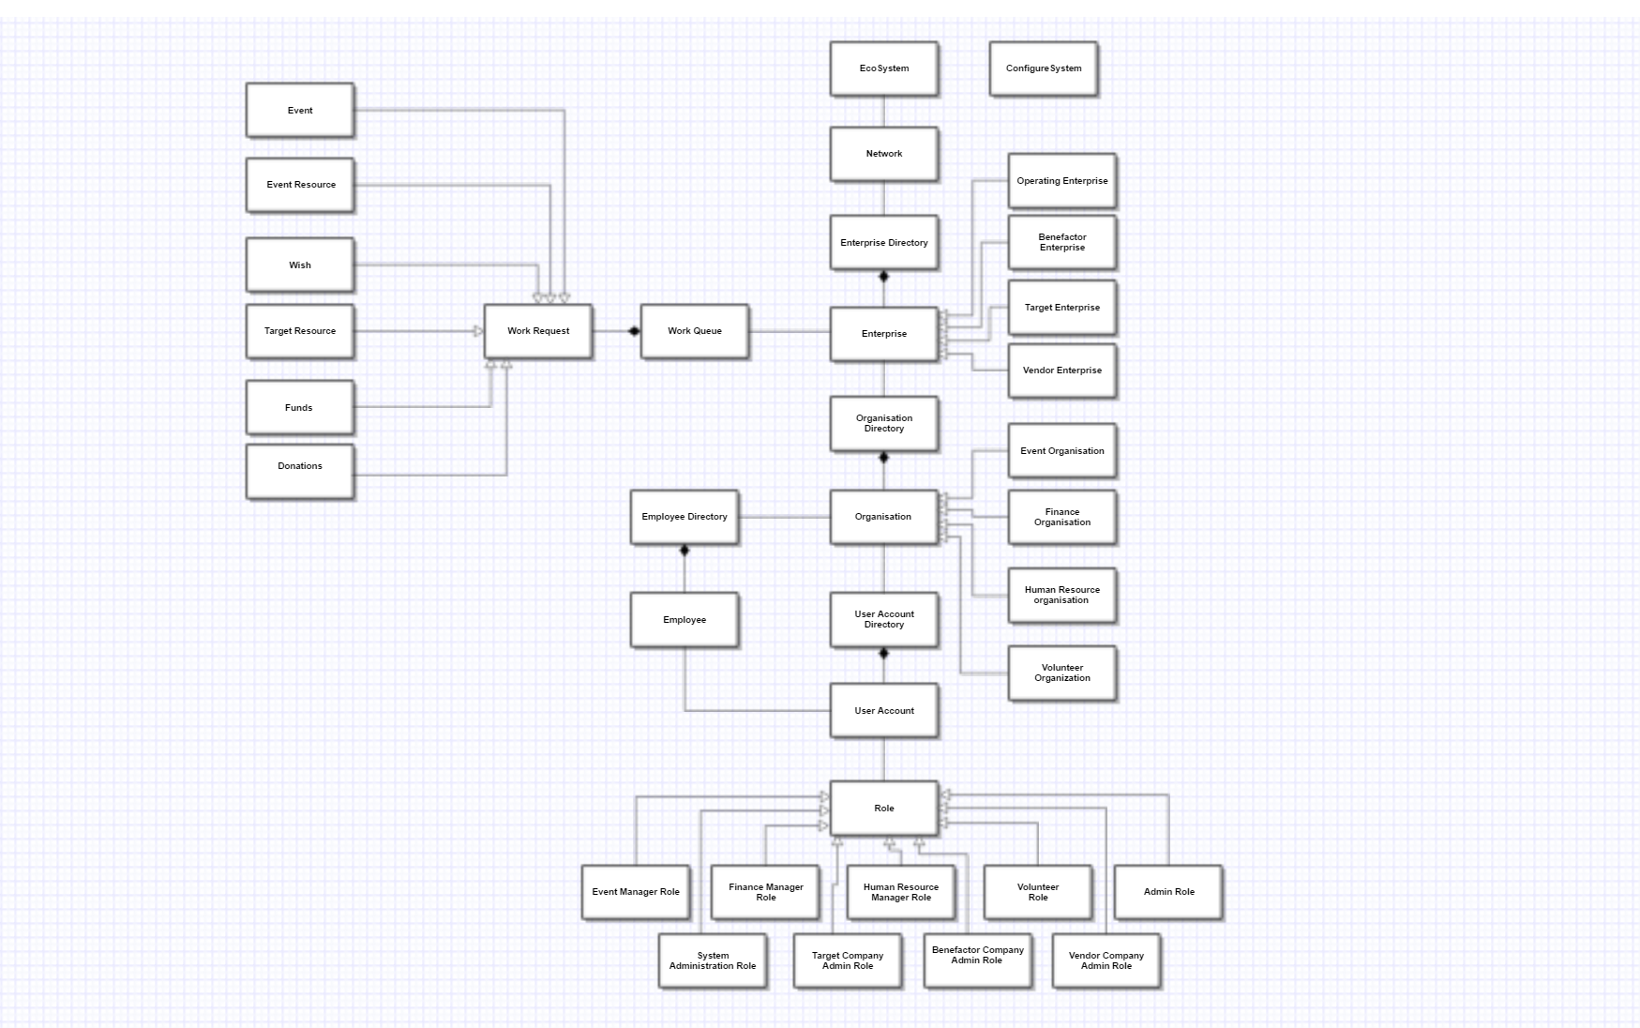
Object Model

Slide 9
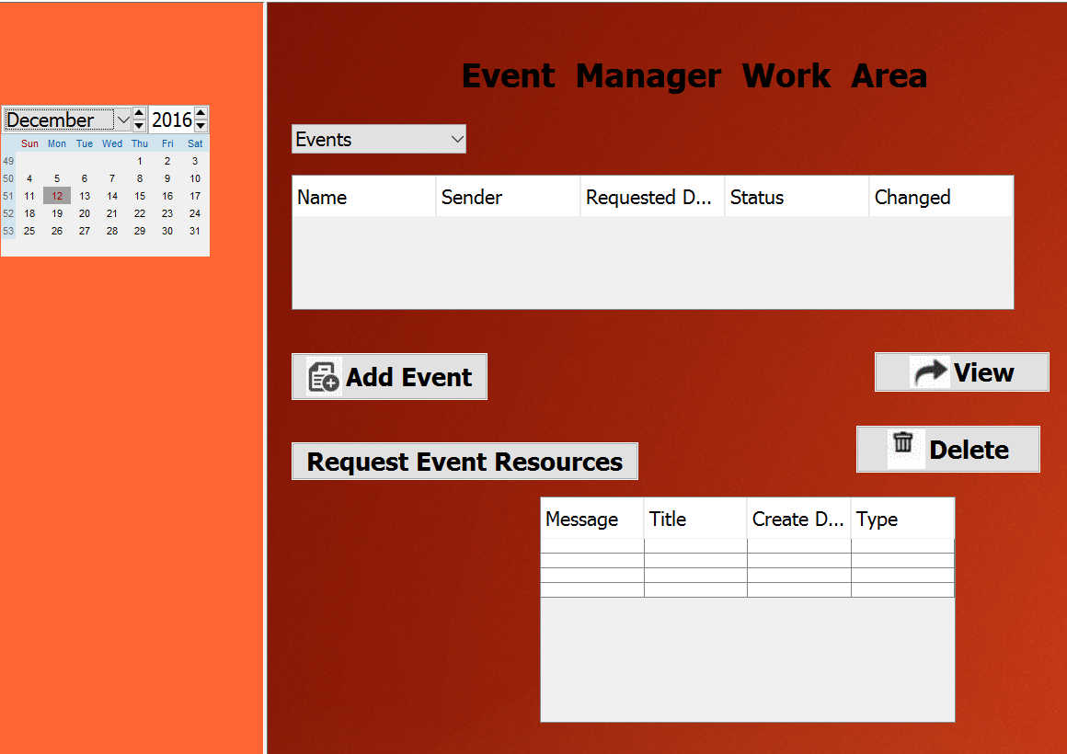
Event Manager Role

Slide 10
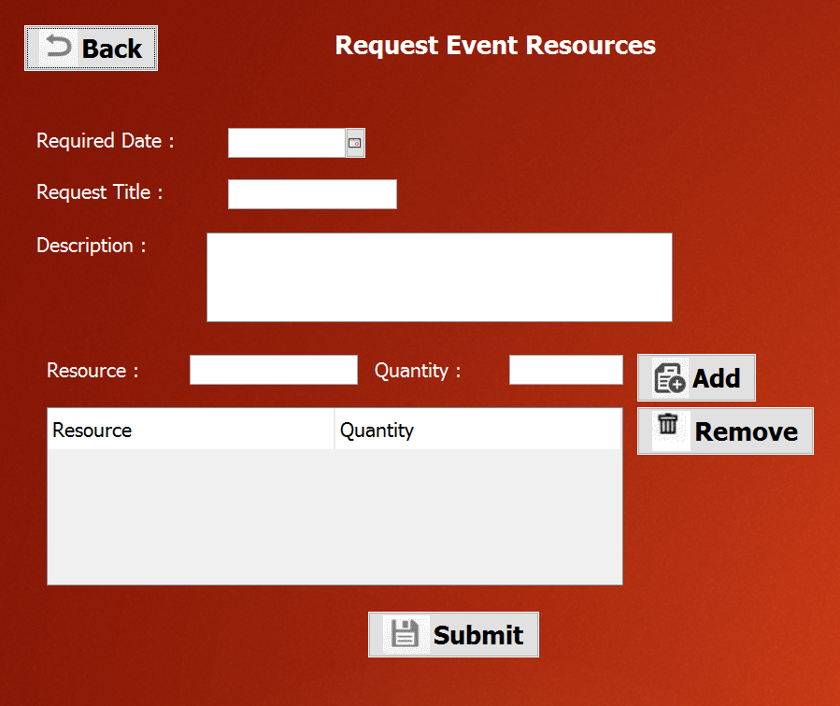
Request Event Resources

Slide 11
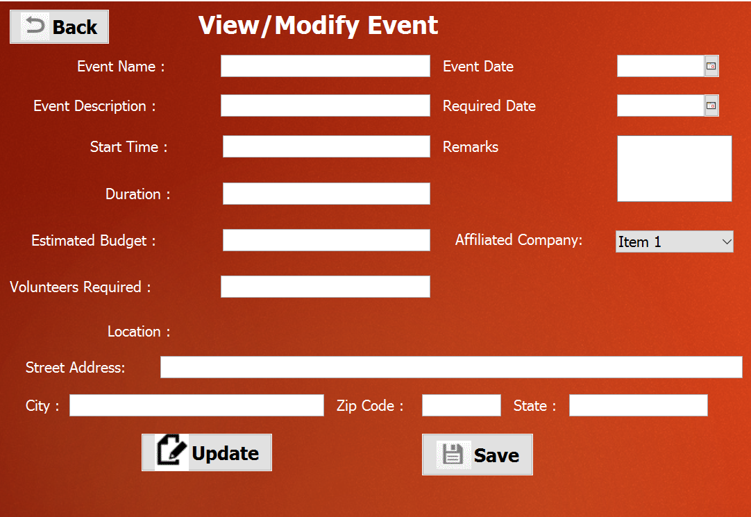
View/Modify Event

Slide 12
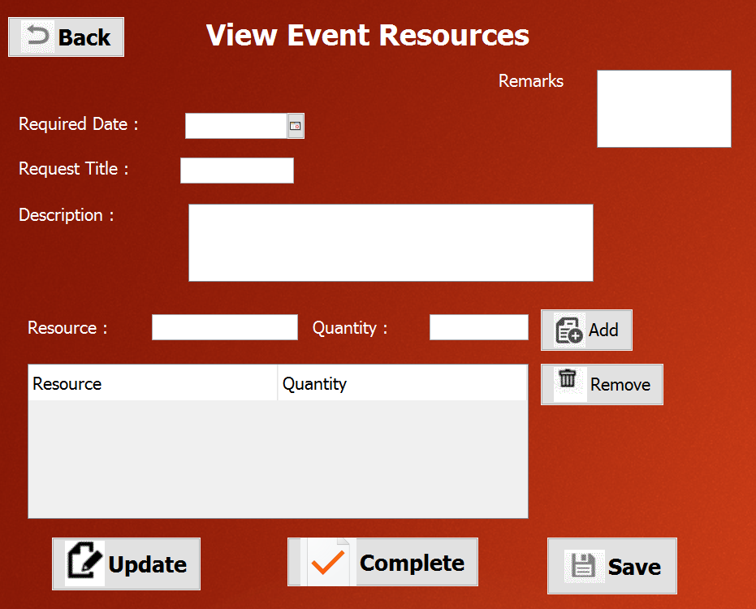
View Event Resources

Slide 13
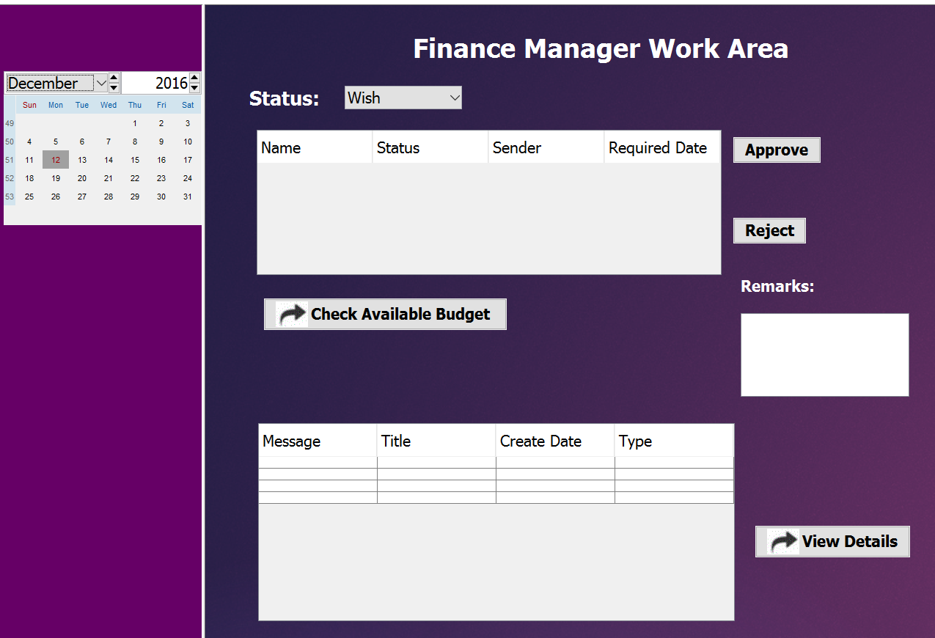
Financial Manager Role

Slide 14
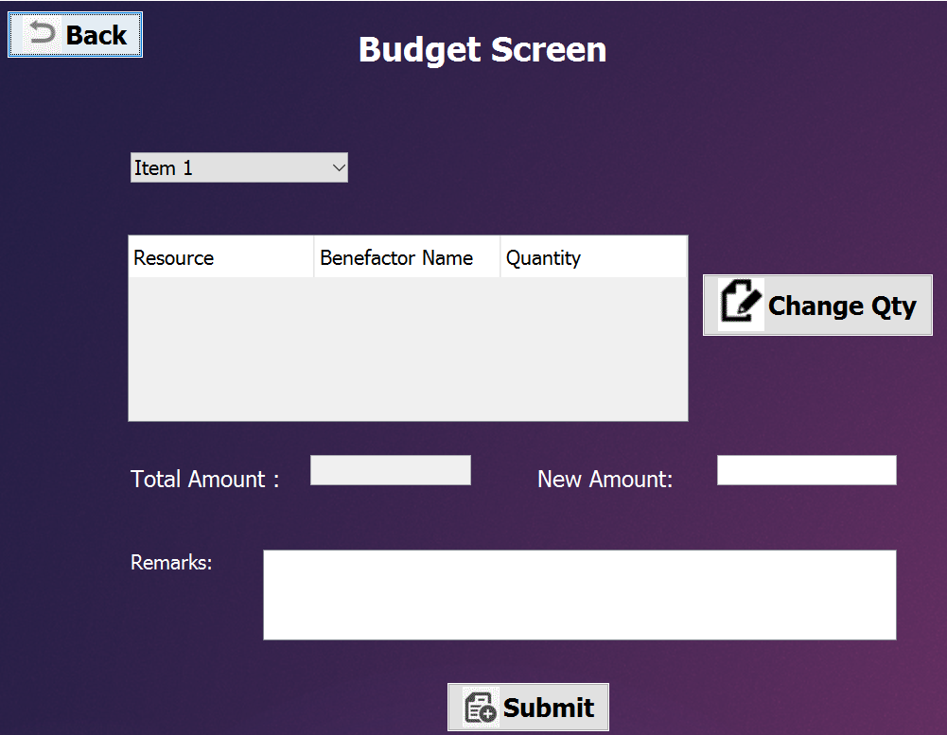
Budget:

Slide 15
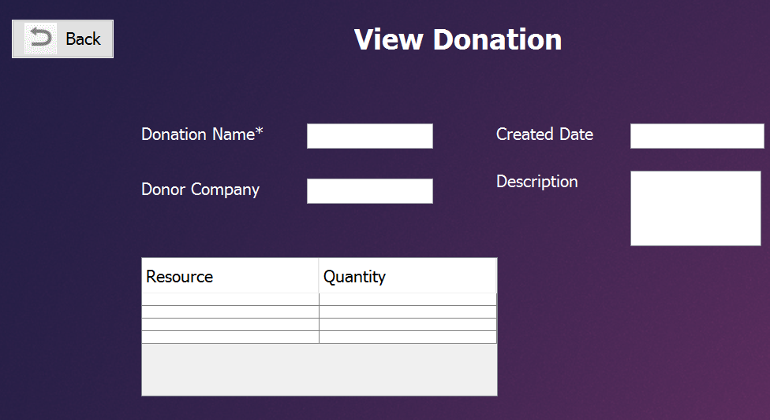
View Donation:

Slide 16
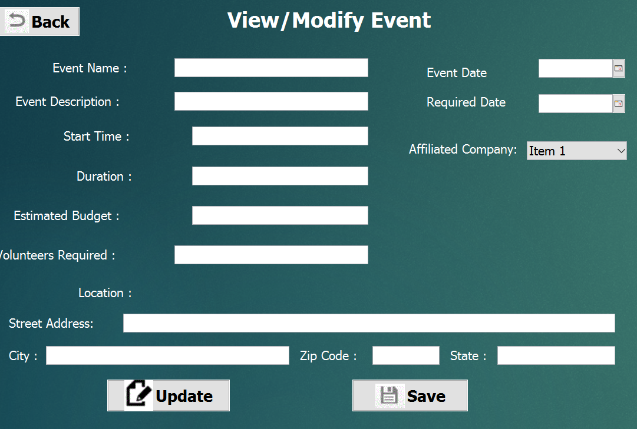
View/Modify Event:

Slide 17
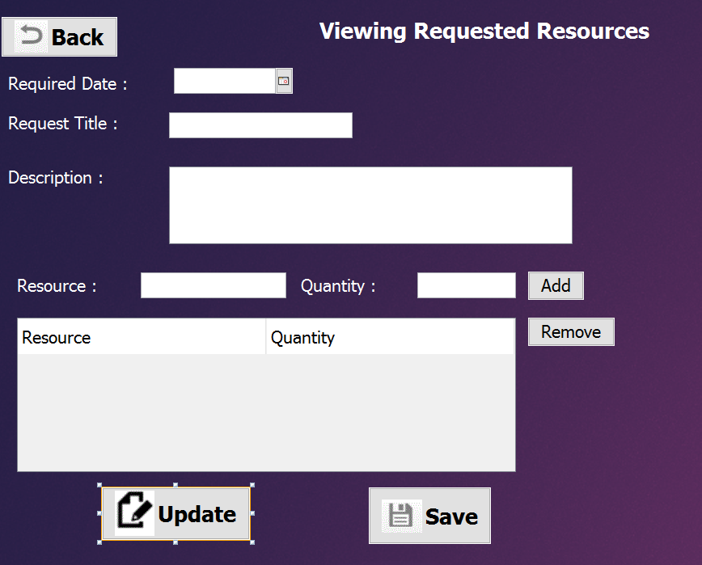
View/Modify Requested Resources:

Slide 18
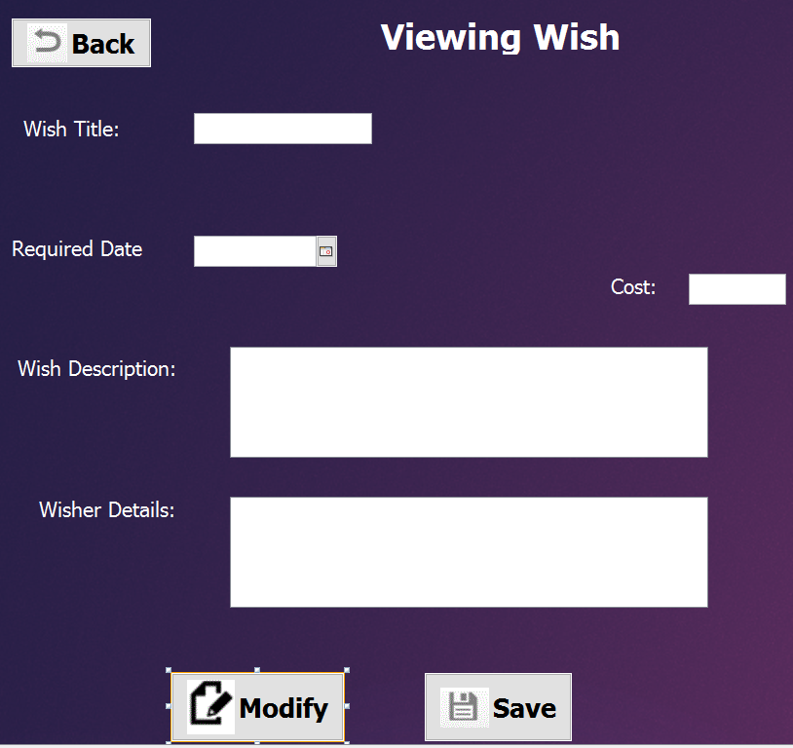
View Requested Wishes:

Slide 19
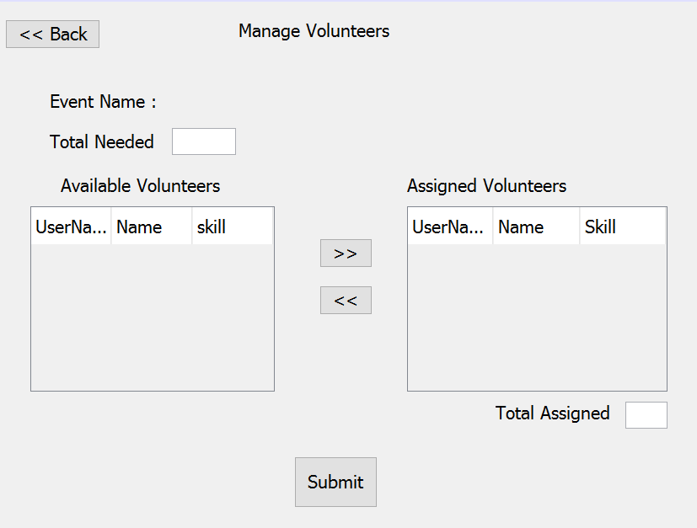
HR Manager Roles:

Slide 20
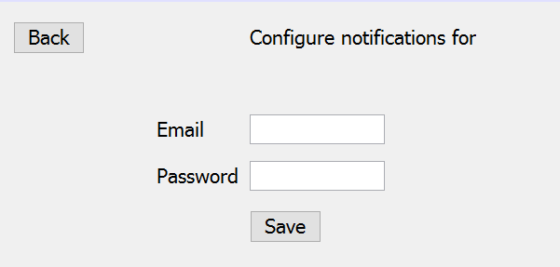
Email Notification

Slide 21
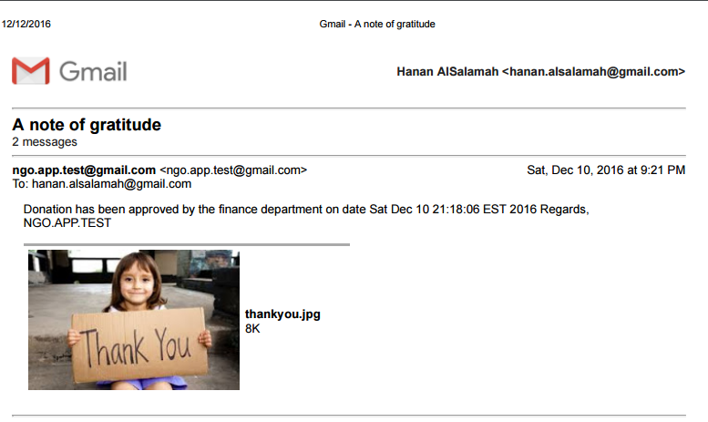
Email Notification:

Slide 22
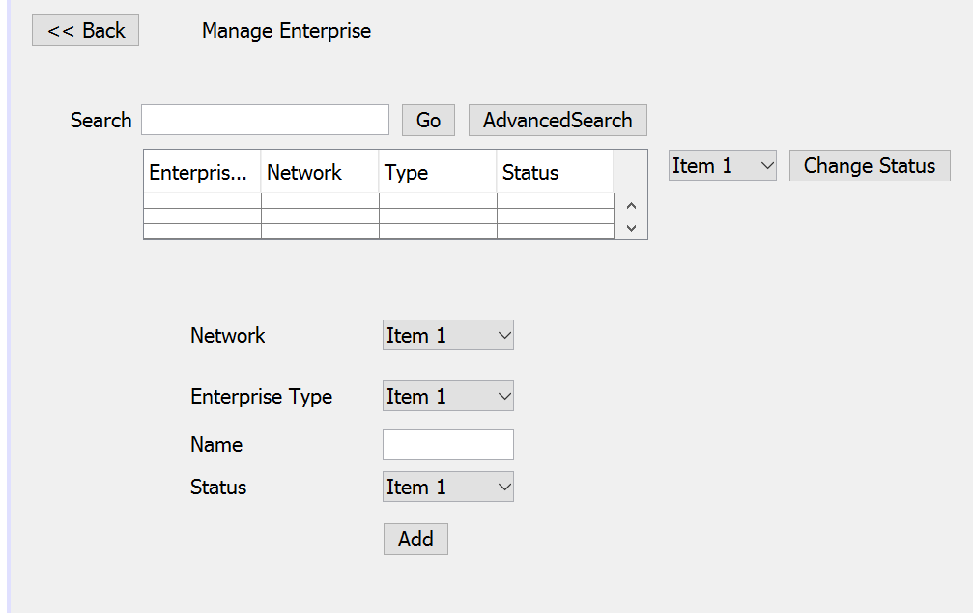
Operating Company Admin Role:

Slide 23
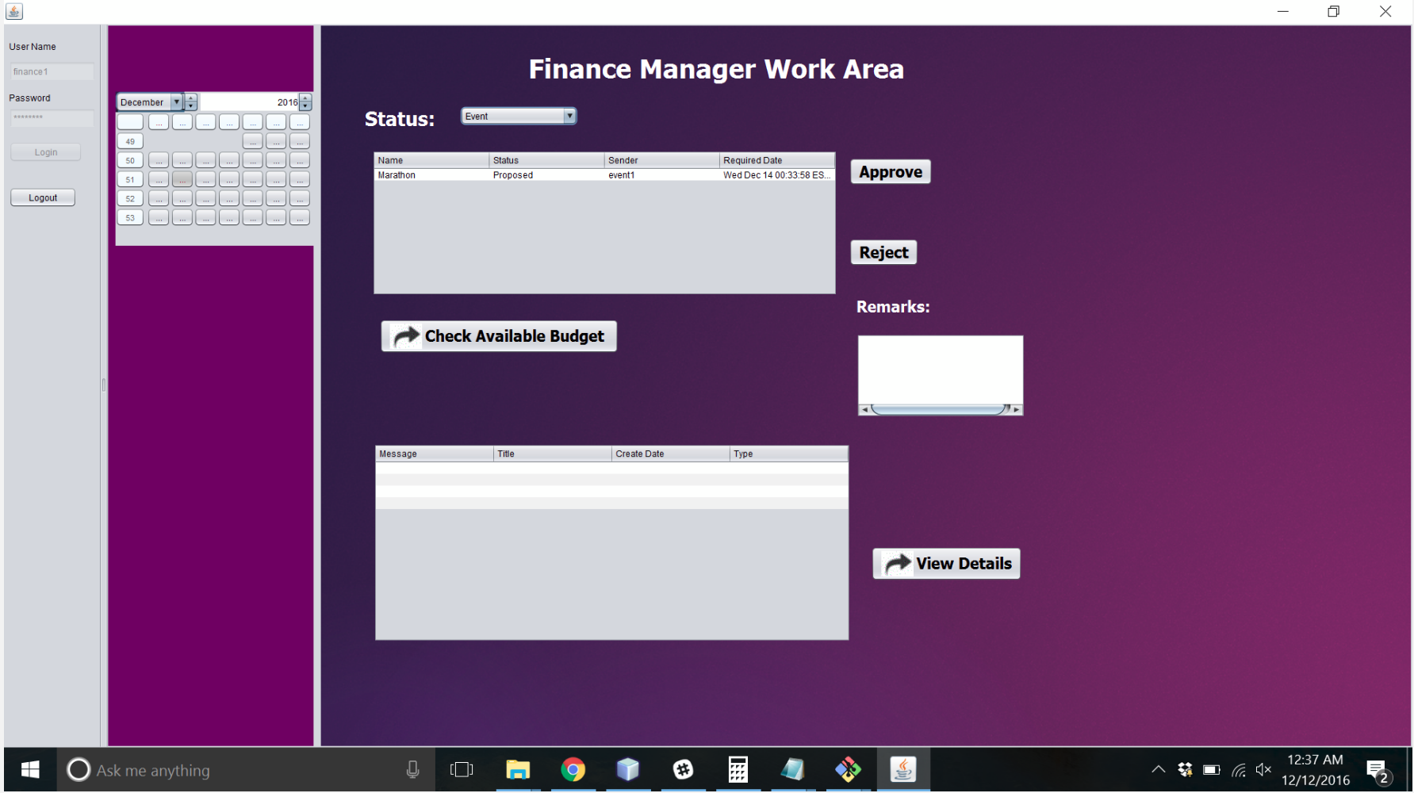
Finance Manager Work Area

Slide 24
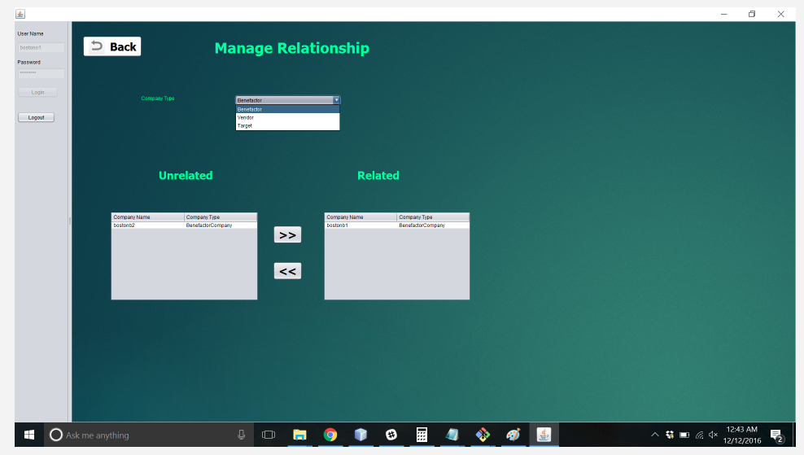
Manage Relationship

Slide 25
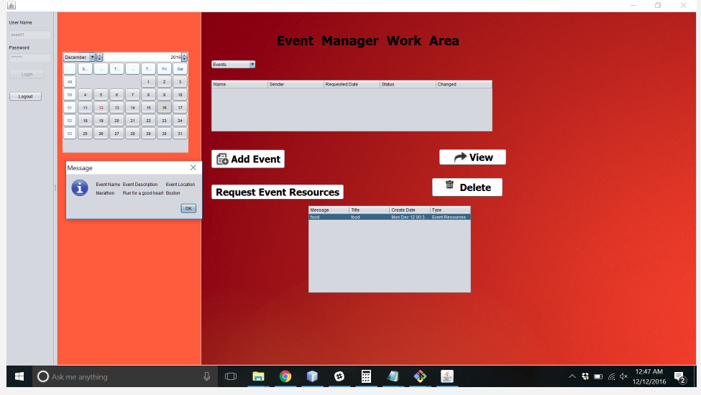
Event Manager Work Area

Slide 26
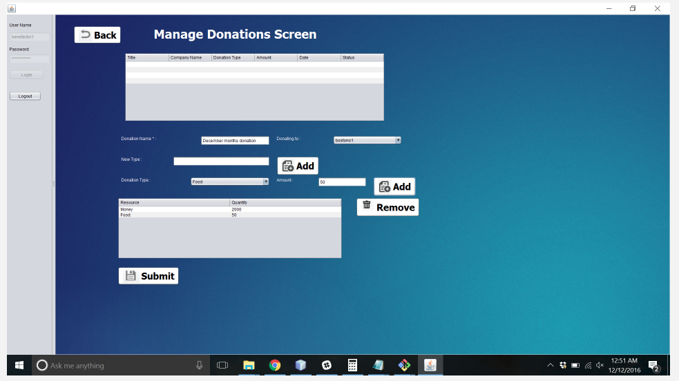
Manage Donations

Slide 27
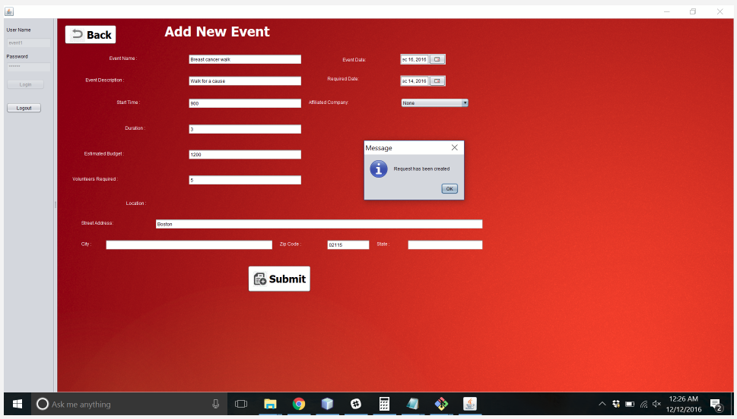
Add New Event

Slide 28
Thank You
Q&A

